Slide 1
Digital Image Processing / Manipulation
(CSC 371)
Lecture # 1: Introduction
1

Slide 2
Course Information
Instructor
Faheem Shaukat
Office Hours
Wednesday and Thursday 12:00 PM to 02:PM
Email before Visit: faheem@iqraisb.edu.pk
2

Slide 3
Course Page
Github.com/faheemshaukat

Slide 4
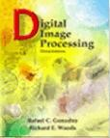
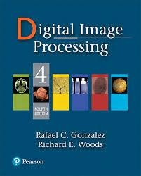
Course Information
Books
Digital Image Processing, Rafael C. Gonzalez & Richard E. Woods, Addison-Wesley
Third Edition
Fourth Edition

Slide 5

Course Objectives
To study the image fundamentals and mathematical transforms necessary for image processing.
Develop an understanding of basic Digital Image Processing techniques through lectures, study, and exercises.
Implement the theoretical concepts discussed in the course to demonstrate your ability of integrating the Mathematical theory with practical issues.

Slide 6




Grading Policy
Projects 20%
Final Term 40%
Quiz 10%
Mid Term 30%
Credits : 3 + 0

Slide 7


How many of you are familiar with

Slide 8
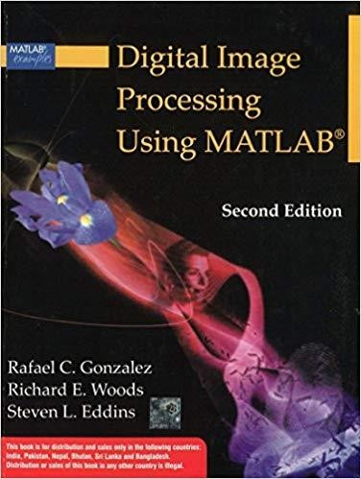
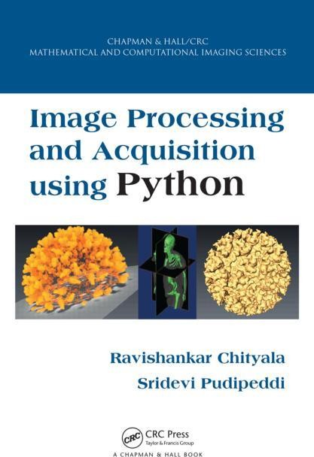
Recommended Books

Slide 9
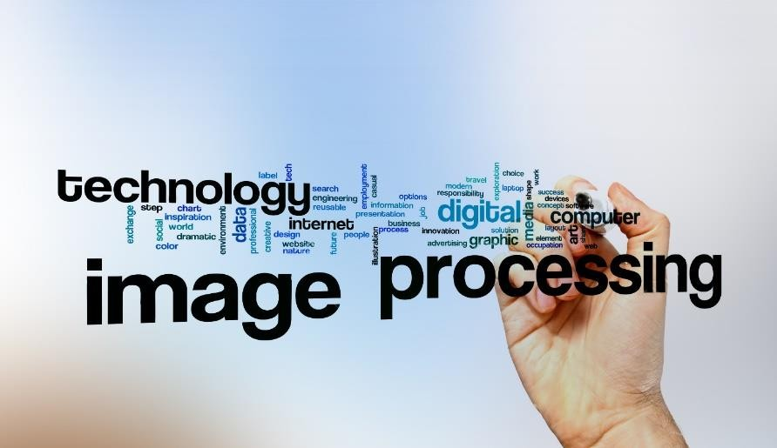
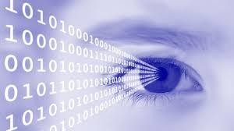

Slide 10
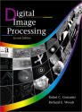
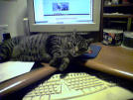
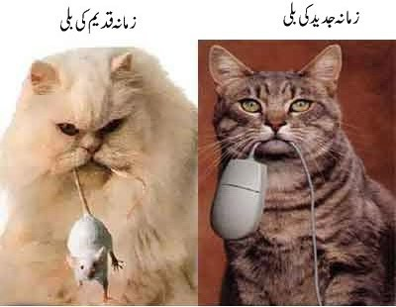
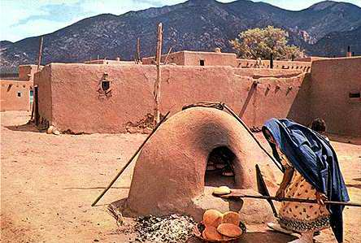
One picture is worth more than ten thousand words

Slide 11
What is an Image?
An image may be defined as a two dimensional function f(x,y) where x and y are spatial coordinates and amplitude of f at any pair of coordinates (x,y) is called the intensity or Gray level of the image at that point.
Digital Image
When x,y and the amplitude values of f are all finite, discrete quantities, we call the image a Digital Image.
A digital Image is composed of a finite number of elements each of which has a particular location and value
These elements are referred to as Picture Elements, Image Elements, Pels, or, Pixels

Slide 12
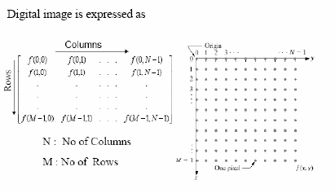
Digital Image

Slide 13
Digital Image Processing
The DIP field refers to processing Digital Images by means of Digital Computer
Related Areas
Image Analysis
Computer Vision (Emulating Human Vision)

Slide 14
Image Processing & Machine Vision
Continuum from Image Processing to Machine Vision:
low, mid and high-level processes
Low Level Process
Input: Image
Output: Image
Examples: Noise removal, image sharpening
Image Processing

Slide 15
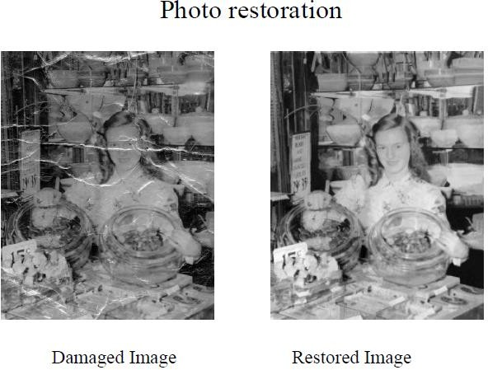
Example: Low Level Processing

Slide 16
Image Processing & Machine Vision
Continuum from Image Processing to Machine Vision:
low, mid and high-level processes
Low Level Process Mid Level Process
Input: Image
Output: Image
Examples: Noise removal, image sharpening
Input: Image
Output: Attributes
Examples: Object recognition, segmentation
Image Processing

Slide 17


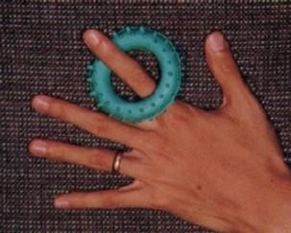

Example: Mid Level Processing
Segmentation of image into regions

Slide 18
Image Processing & Machine Vision
Continuum from Image Processing to Machine Vision:
low, mid and high-level processes
Low Level Process Mid Level Process High Level Process
Input: Image
Output: Image
Examples: Noise removal, image sharpening
Input: Image
Output: Attributes
Examples: Object recognition, segmentation
Input: Attributes/Image
Output: Understanding
Examples: Scene understanding, autonomous navigation
Image Processing
Machine Vision

Slide 19
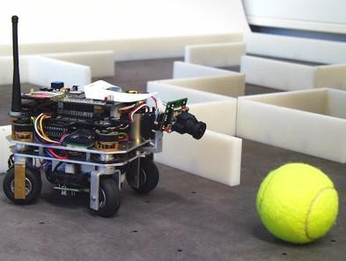
Example: High Level Processing
Robot Navigation

Slide 20


Image Processing & Machine Vision
Continuum from Image Processing to Machine
Vision:
low, mid and high-level processes
In this course
Low Level Process Mid Level Process
High Level Process
Input: Image
Output: Image
Examples: Noise removal, image sharpening
Input: Image
Output: Attributes
Examples: Object recognition, segmentation
Input: Attributes/Image
Output: Understanding
Examples: Scene understanding, autonomous navigation
Image Processing
Machine Vision

Slide 21

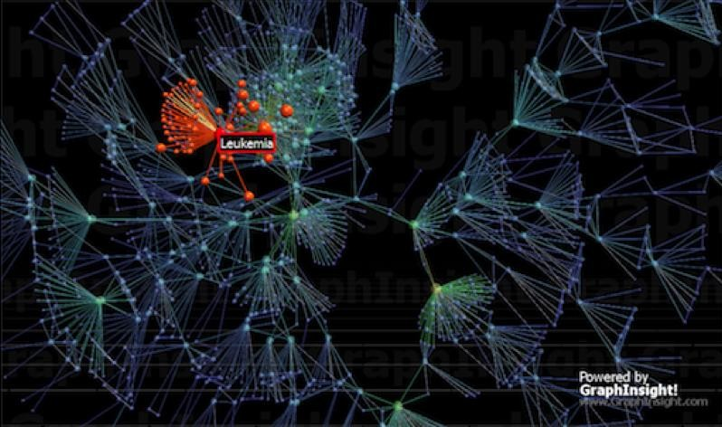

Slide 22
Applications of Image Processing

Slide 23
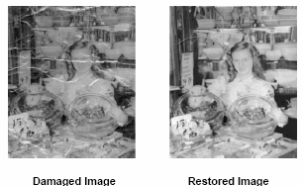
Image Restoration

Slide 24
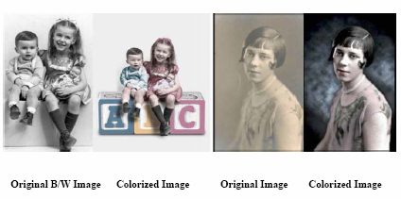
Image Colorization

Slide 25
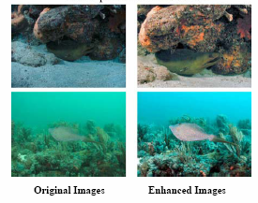
Image Enhancement

Slide 26
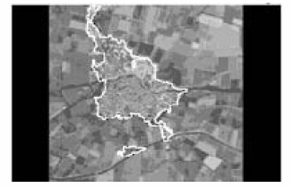
Extraction of Satellite Area from an Aerial Image

Slide 27
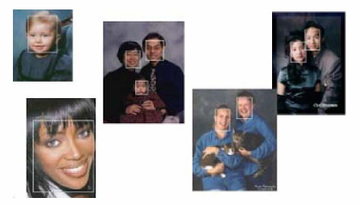
Face Detection

Slide 28
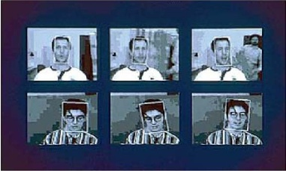
Face Tracking

Slide 29
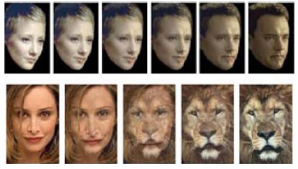
Face Morphing

Slide 30
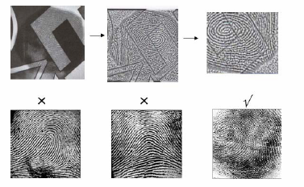
Finger Print Recognition

Slide 31
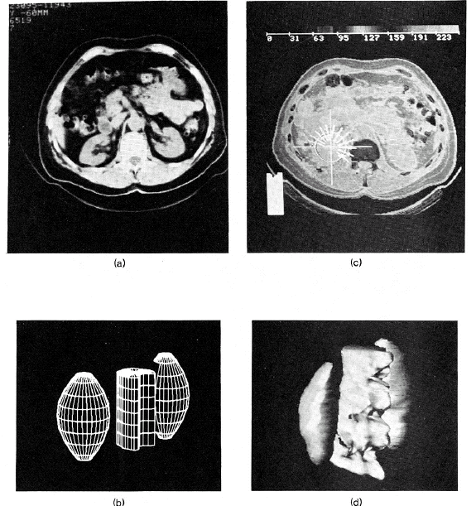
Application: Medical Imaging
Scan Data
Model Fitting
Prototype Kidney Model
Resulting Kidney and spinal cord instance

Slide 32
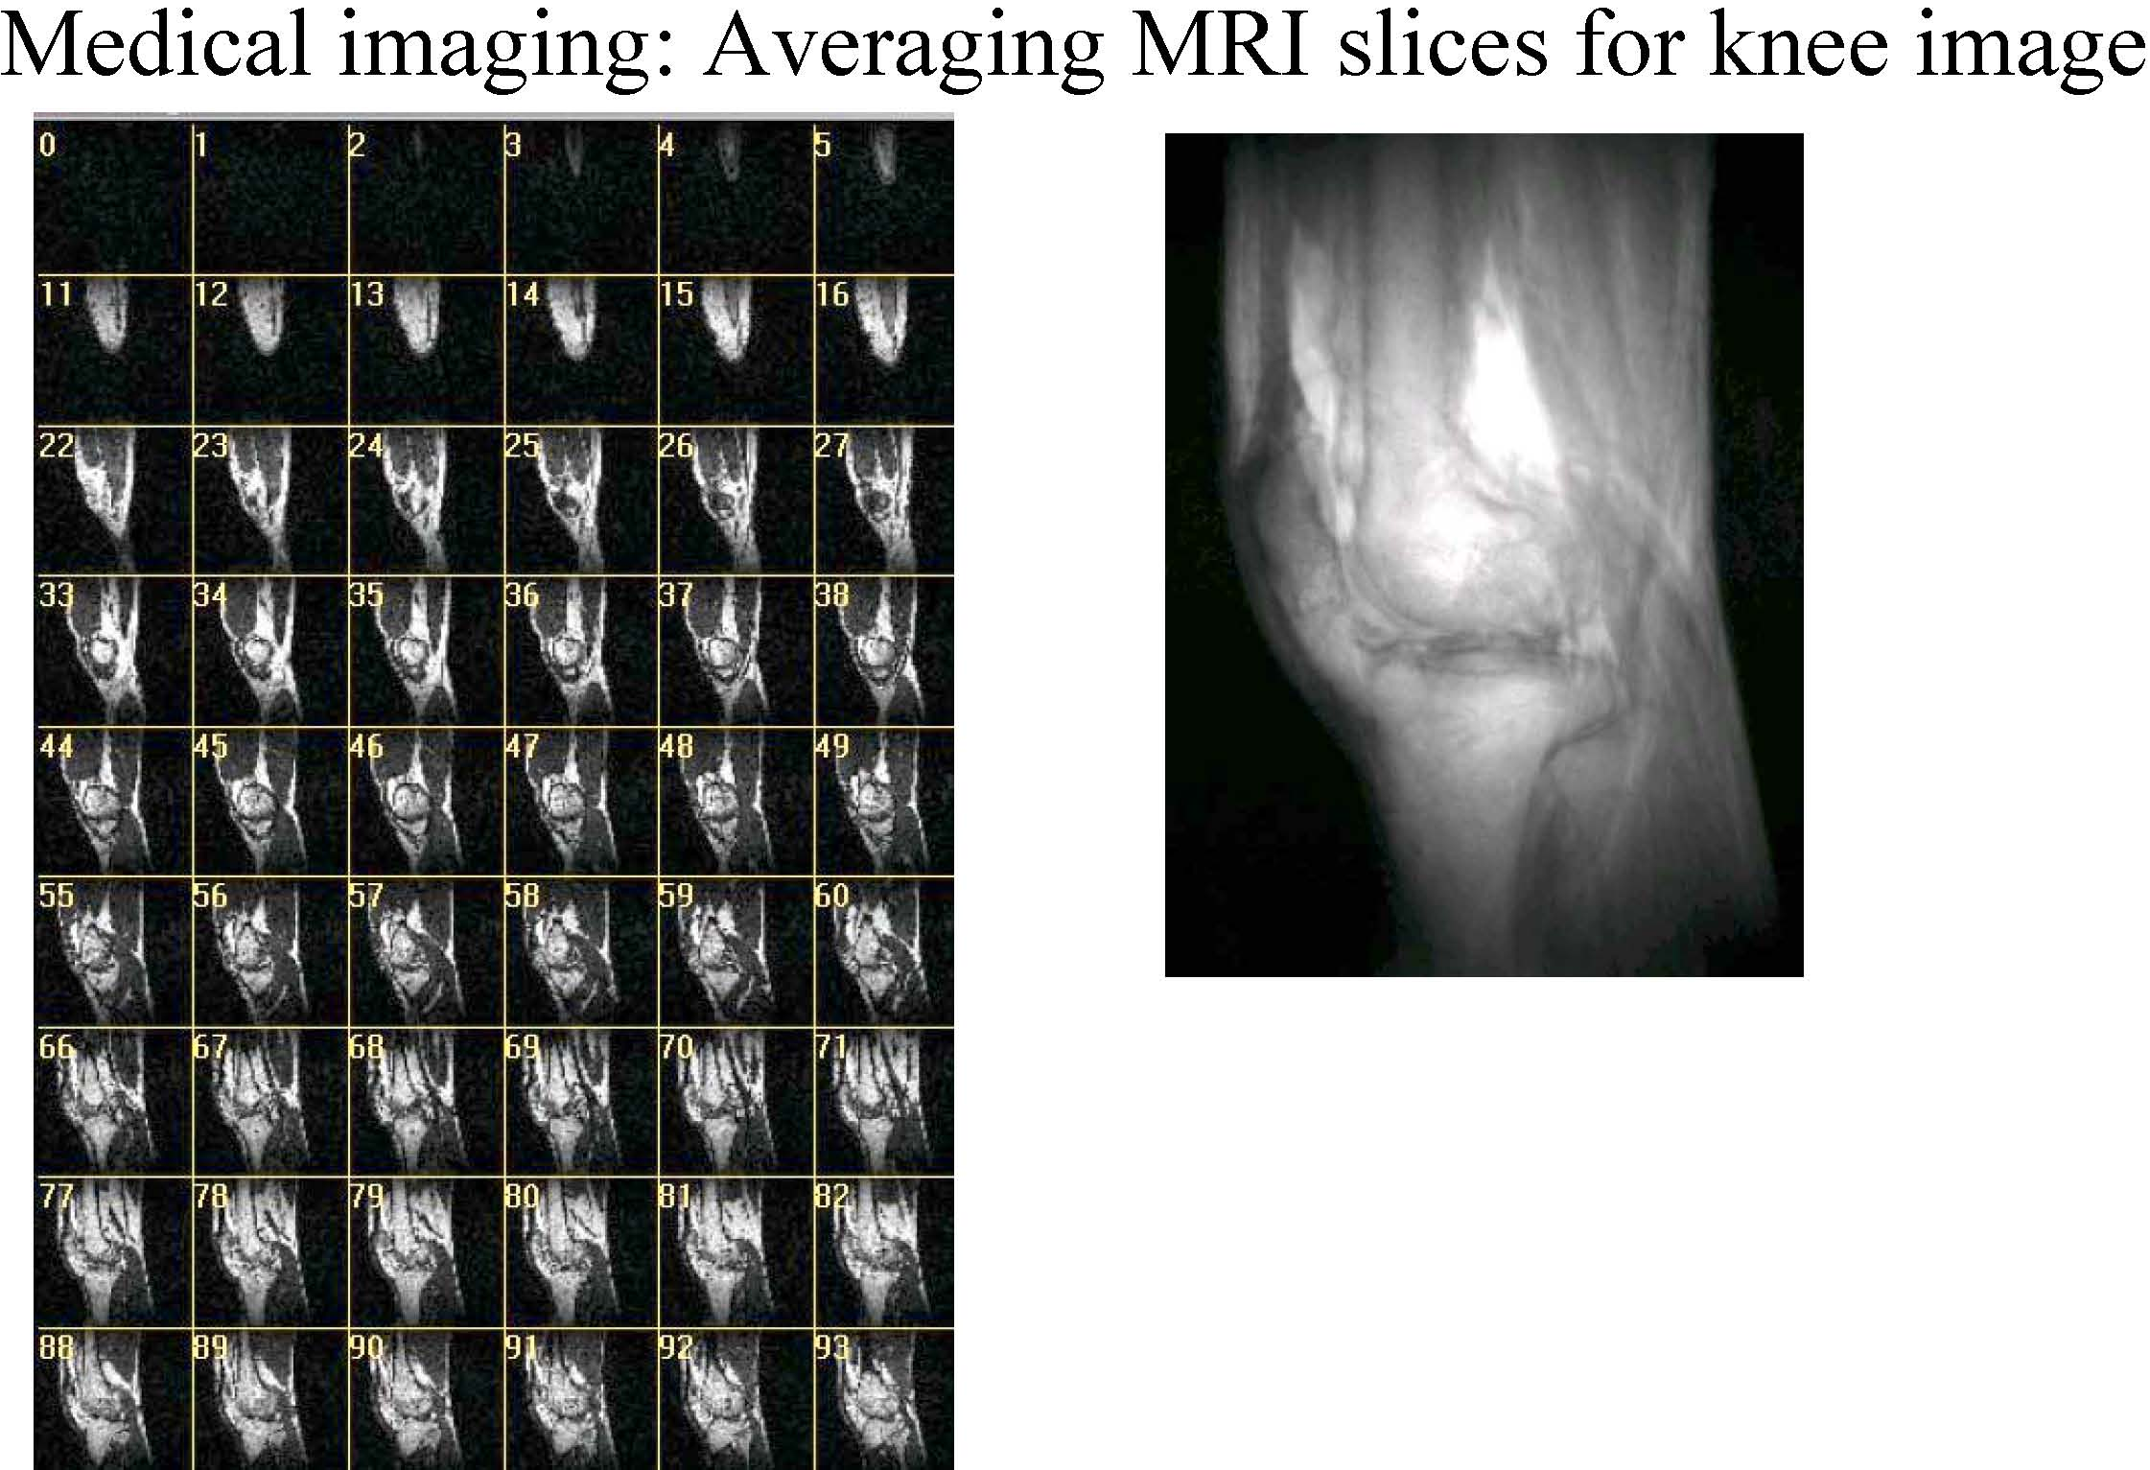
Image Processing Examples
Magnetic Resonance Imaging (MRI) is useful for scanning tissues

Slide 33
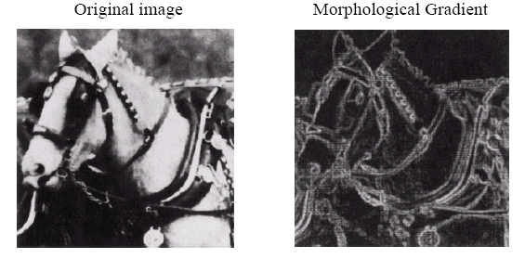
Image Processing Examples
Edge Extraction

Slide 34
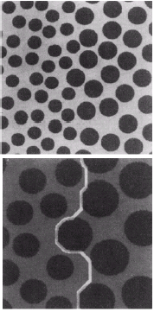
Image Processing Examples
Segmentation

Slide 35
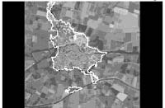
Image Processing Examples
Extraction of Settlement Area from and Arial image

Slide 36
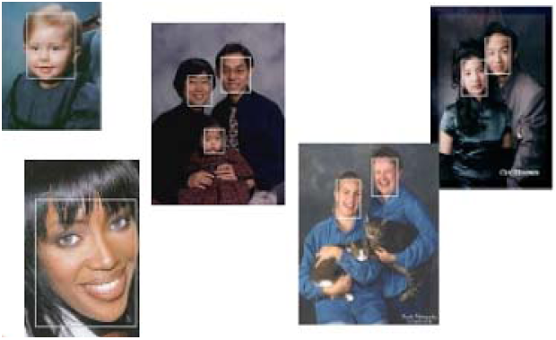
Image Processing Examples
Face Detection
Image shows the ground displacement of a typical area due to earthquake

Slide 37

Image Processing Examples
Face Tracking
Image shows the ground displacement of a typical area due to earthquake

Slide 38
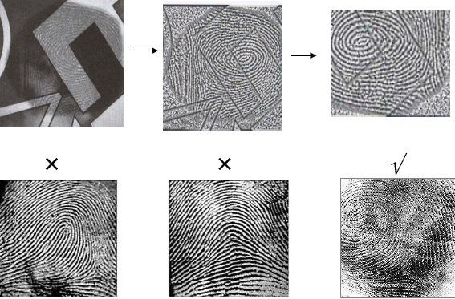
Image Processing Examples
Fingerprint Recognition
Faulty Image of Saturn Recovered Image

Slide 39
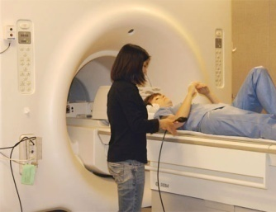
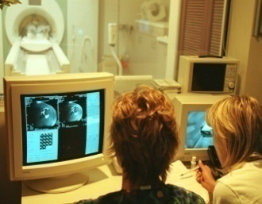
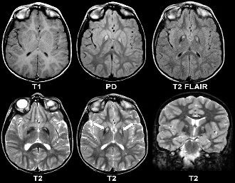
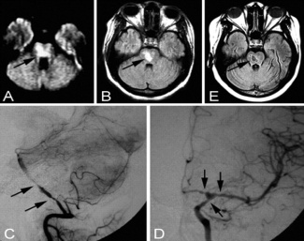
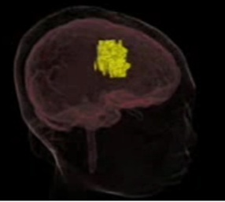
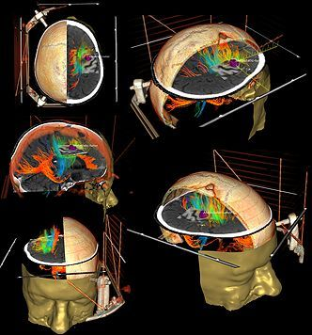
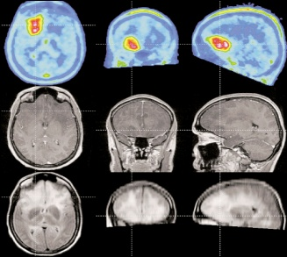
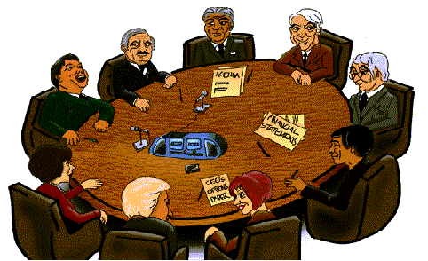
Brain Tumor Detection and 3D Visualization: The Process
Scanning MRI Images
through MRI Machine
Brain MRI Scans
in DICOM Format
Brain MRI Scans
in bmp Format
Brain Image Segmentation & Comparison
3D tumor visualization
3D Brain Modeling
2D Tumor Detection
Semantic Decision Support

Slide 40
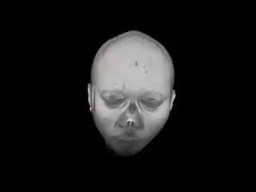
3D Visualization of Brain Tumor

Slide 41
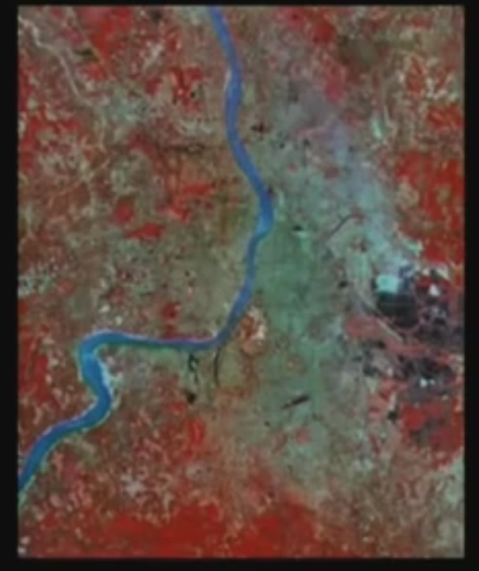
Remote Sensing

Slide 42
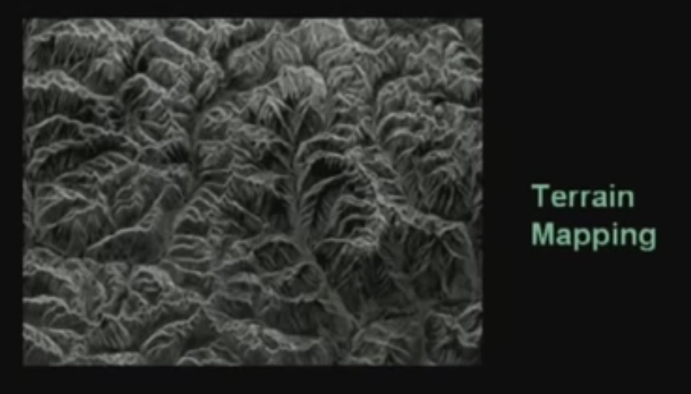
Remote Sensing

Slide 43
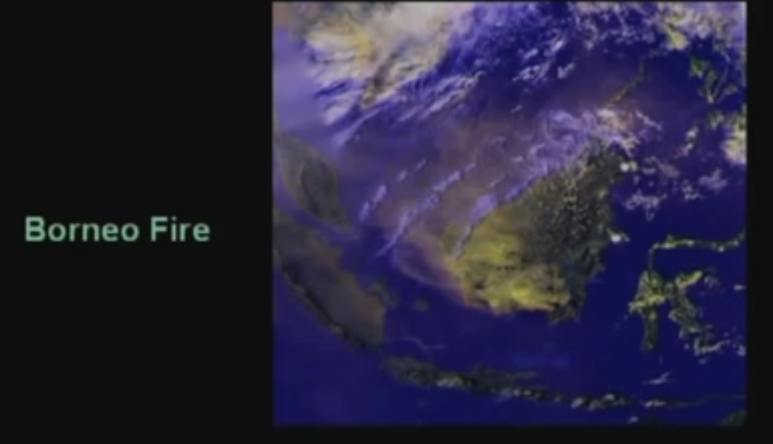
Remote Sensing

Slide 44
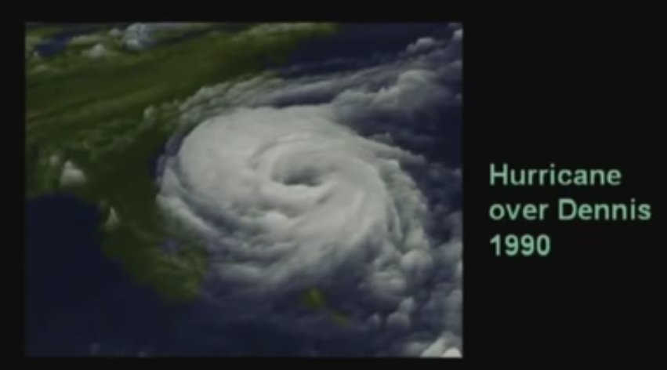
Weather Forecasting

Slide 45
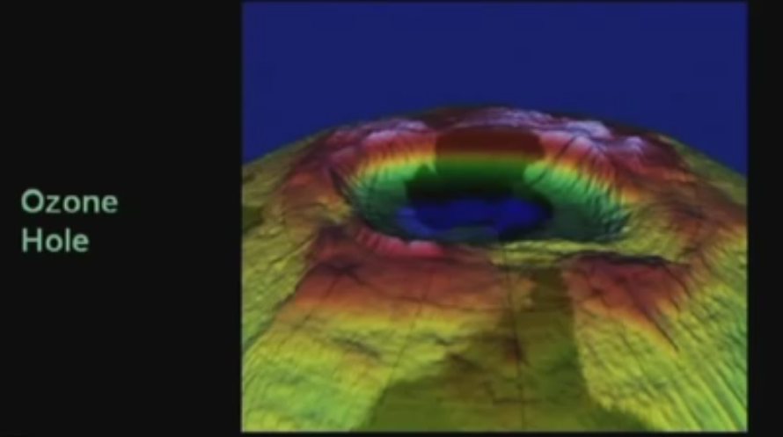
Atmospheric study

Slide 46
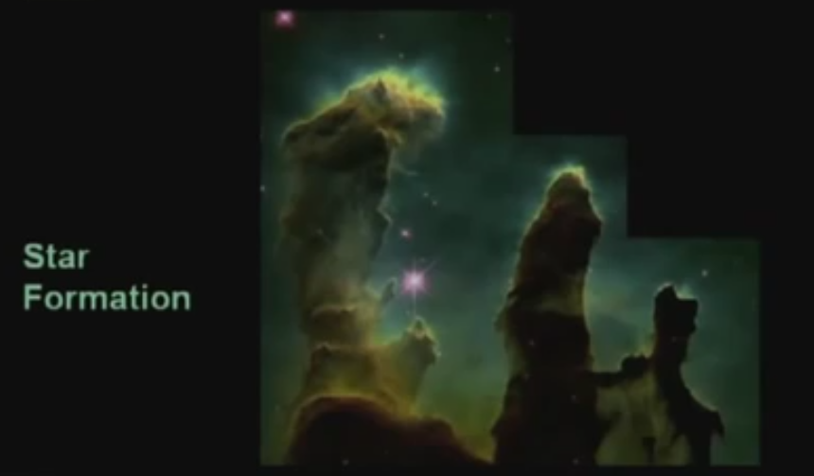
Astronomy

Slide 47
Machine vision applications
Extract the image information for further computer processing
Common applications are:
Industrial machine vision for product assembly and inspection
Automated target detection and tracking
Finger print recognition
Machine processing of aerial and satellite imagery for weather prediction and crop assessment

Slide 48
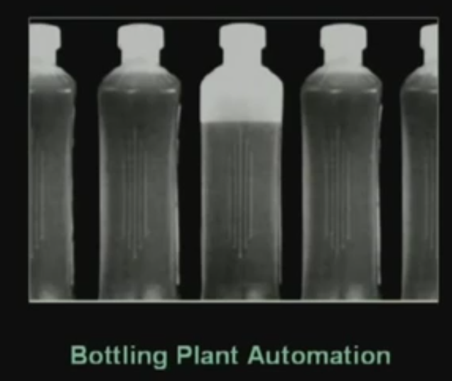
Automated inspection

Slide 49
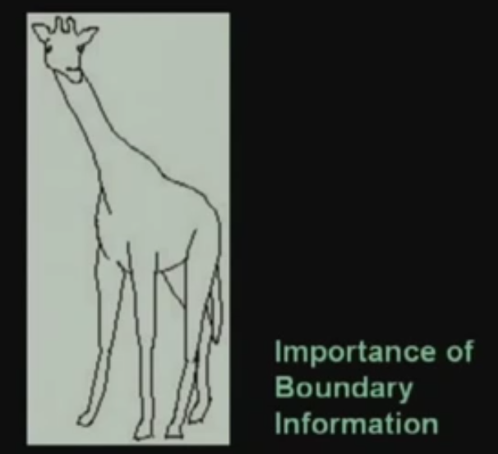
Boundary Information

Slide 50
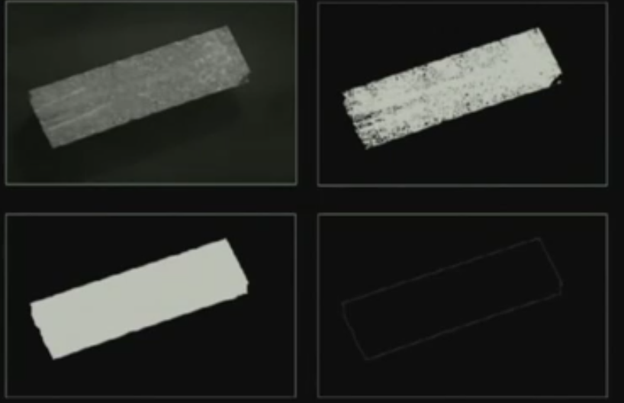
Automated inspection

Slide 51
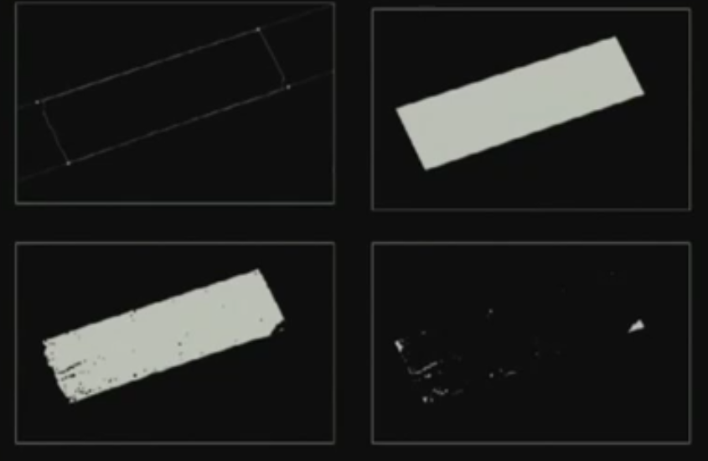
Automated inspection

Slide 52
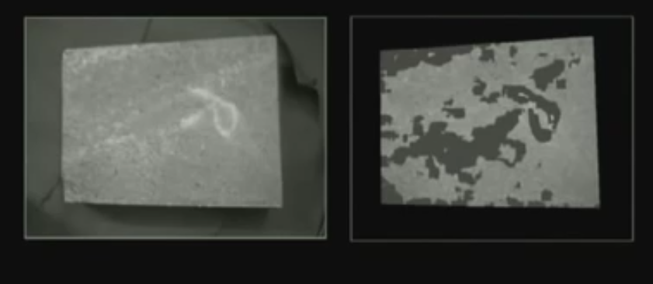
Surface information

Slide 53

Automated inspection

Slide 54

UAV Imagery
Image Sensing

Slide 55

UAV Imagery
Image Sensing
Image Mosaicing

Slide 56
UAV Imagery
Image Sensing Image Mosaicing Image Tiling
For viewing in multi-resolution

Slide 57
UAV Imagery
Image Sensing Image Mosaicing Image Tiling Image Overlaying
Satellite image overlay
Other details overlay

Slide 58


Object Tracking
Method
Background Subtraction
Frame differences
Tracking window

Slide 59

Object Tracking
Method
Size and Shape variation

Slide 60

Object Tracking
Method
Size and Shape variation
Occlusion

Slide 61

Object Tracking
Method
Size and Shape variation Occlusion
Multiple Objects

Slide 62

Object Tracking
Method
Size and Shape variation Occlusion
Multiple Objects
Human Tracking

Slide 63


Steganography
Method

Slide 64

Steganography
Method
Encrypting and Concealing secret message
Original Image
Modified Image

Slide 65

Steganography
Method
Encrypting and Concealing secret message
Image Watermarking

Slide 66

Gesture Recognition
Simple gestures: To control or interact with devices without physically touching them

Slide 67


Gesture Recognition
Simple gestures: To control or interact with devices without physically touching them
Sign Language

Slide 68


Gesture Recognition
Simple gestures: To control or interact with devices without physically touching them
Sign Language Gaming

Slide 69

Gesture Recognition
Simple gestures: To control or interact with devices without physically touching them
Sign Language Gaming
Disable

Slide 70


Face Recognition
Face Detection

Slide 71



Face Recognition
Face Detection
Face Recognition

Slide 72

Face Recognition
Face Detection
Face Recognition

Slide 73


Face Recognition
Face Detection Face Recognition
3D Face Recognition

Slide 74


Face Recognition
Face Detection Face Recognition
3D Face Recognition
Emotion Recognition

Slide 75



Face Recognition
Face Detection Face Recognition
3D Face Recognition
Emotion Recognition
Gaze Tracking

Slide 76




Virtual Reality
Stereoscopy

Slide 77

Virtual Reality
Stereoscopy
Virtual Reality

Slide 78



Virtual Reality
Stereoscopy Virtual Reality 3D simulators

Slide 79


Virtual Reality
Stereoscopy Virtual Reality 3D simulators
Augmented Reality

Slide 80

Image Editing
Image Completion

Slide 81


Image Editing
Image Completion
Image Stitching

Slide 82

Image Editing
Image Completion Image Stitching Image Registration

Slide 83



Image Editing
Image Completion Image Stitching Image Registration Image Morphing

Slide 84



Image Editing
Image Completion Image Stitching Image Registration Image Morphing Image Warping

Slide 85


Image Enhancement
Contrast Enhancement

Slide 86


Image Enhancement
Contrast Enhancement
Local Enhancement

Slide 87

Image Enhancement
Contrast Enhancement Local Enhancement Image Restoration

Slide 88


Image Enhancement
Contrast Enhancement Local Enhancement Image Restoration
Fog Removal

Slide 89

Traffic Control
Controlling signals

Slide 90

Traffic Control
Controlling signals Monitoring traffic flow

Slide 91

Traffic Control
Controlling signals Monitoring traffic flow Vehicle searching

Slide 92

Traffic Control
Controlling signals Monitoring traffic flow Vehicle searching Number plate recognition

Slide 93

Traffic Control
Controlling signals Monitoring traffic flow Vehicle searching Number plate recognition Traffic Safety

Slide 94

Traffic Control
Controlling signals Monitoring traffic flow Vehicle searching Number plate recognition Traffic Safety
Vehicle Camera

Slide 95





Medical Imaging
Process of creating visual representations of the interior of a body for clinical analysis and medical intervention
Imaging Technologies
X-ray
MRI
CT Scan
Ultrasound
Endoscopy
Elastography
Thermography
Angiography
Nuclear medicine imaging

Slide 96

Examples: Medical Imaging
Microscopic tissue data - Cancer Detection
60

Slide 97



CCTV Monitoring
Major Uses
Business: monitoring employees, prevent crimes, reduce cost & risk, and help in investigation
Home: Monitoring outside, babies, baby sitter and remote monitoring of home
Traffic monitoring: Traffic conditions, congestion, accidents
Industrial Processes

Slide 98
CCTV Monitoring
Installation
Schools
Offices
Homes
Factories
Highways
Airports
Haram
Sensitive Installations

Slide 99


CCTV Monitoring
Human Factor
Average CCTV operator sees boring picture of deserted hallway, parking, back doors, lobbies , or an elevator from his chair for 6 or 8 hours a day
He gets fatigued and loose concentration
Thus, an ineffective solution

Slide 100


CCTV Monitoring
Solution: Automation
Extraction of information from images
Understanding problem situation
Self decision
Smart Cameras: consist of
image sensor
Memory
Communication interface
Built in illumination
Real-time operating system
Image Processing software

Slide 101

Weapon Systems
Air Defense Systems

Slide 102

Weapon Systems
Anti Aircraft Gun

Slide 103

Weapon Systems
Rifle

Slide 104


Biometrics
Biometrics - Authentication techniques
Physiological Biometrics
Face, IRIS, DNA, Finger Prints
Behavioral Biometrics
Typing Rhythm, Handwriting, Gait

Slide 105


Robotics

Slide 106



Examples: Robotics
AIBO

Slide 107
Summary of Applications
Problem Domain | Application | Input Pattern | Output Class
Document Image Analysis | Optical Character Recognition | Document Image | Characters/words
Document Classification | Internet search | Text Document | Semantic categories
Document Classification | Junk mail filtering | Email | Junk/Non-Junk
Multimedia retrieval | Internet search | Video clip | Video genres
Speech Recognition | Telephone directory assistance | Speech waveform | Spoken words
Natural Language Processing | Information extraction | Sentence | Parts of Speech
Biometric Recognition | Personal identification | Face, finger print, Iris | Authorized users for access control
Medical | Computer aided diagnosis | Microscopic Image | Healthy/cancerous cell
Military | Automatic target recognition | Infrared image | Target type
Industrial automation | Fruit sorting | Images taken on conveyor belt | Grade of quality
Bioinformatics | Sequence analysis | DNA sequence | Known types of genes

Slide 108
Key Stages in DIP
Image
Restoration
Morphological
Processing
Image
Enhancement
Segmentation
Image Acquisition
Representation & Description
Object Recognition
Problem Domain
Colour Image
Processing
Image
Compression

Slide 109

Key Stages in DIP
Image
Restoration
Morphological
Processing
Image
Enhancement
Segmentation
Image Acquisition
Representation & Description
Object Recognition
Problem Domain
Colour Image
Processing
Image
Compression

Slide 110


Key Stages in DIP
Image
Restoration
Morphological
Processing
Image
Enhancement
Segmentation
Image Acquisition
Representation & Description
Object Recognition
Problem Domain
Colour Image
Processing
Image
Compression

Slide 111


Key Stages in DIP
Image
Restoration
Morphological
Processing
Image
Enhancement
Segmentation
Image Acquisition
Representation & Description
Object Recognition
Problem Domain
Colour Image
Processing
Image
Compression

Slide 112

Key Stages in DIP
Image
Restoration
Morphological
Processing
Image
Enhancement
Segmentation
Image Acquisition
Representation & Description
Object Recognition
Problem Domain
Colour Image
Processing
Image
Compression

Slide 113

Key Stages in DIP
Image
Restoration
Morphological
Processing
Image
Enhancement
Segmentation
Image Acquisition
Representation & Description
Object Recognition
Problem Domain
Colour Image
Processing
Image
Compression

Slide 114

Key Stages in DIP
Image
Restoration
Morphological
Processing
Image
Enhancement
Segmentation
Image Acquisition
Representation & Description
Object Recognition
Problem Domain
Colour Image
Processing
Image
Compression

Slide 115

Key Stages in DIP
Image
Restoration
Morphological
Processing
Image
Enhancement
Segmentation
Image Acquisition
Representation & Description
Object Recognition
Problem Domain
Colour Image
Processing
Image
Compression

Slide 116

Key Stages in DIP
Image
Restoration
Morphological
Processing
Image
Enhancement
Segmentation
Image Acquisition
Representation & Description
Object Recognition
Problem Domain
Colour Image
Processing
Image
Compression

Slide 117

Key Stages in DIP
Image
Restoration
Morphological
Processing
Image
Enhancement
Segmentation
Image Acquisition
Representation & Description
Object Recognition
Problem Domain
Colour Image
Processing
Image
Compression

Slide 118
Acknowledgements
Material in these slides has been taken from, the following resources
Guest Lecture by Dr. Asif Masood “Latest trends in Image Processing”
Pattern Recognition and Analysis Course – A.K. Jain, MSU
Pattern Classification” by Duda et al., John Wiley & Sons.
Digital Image Processing”, Rafael C. Gonzalez & Richard E. Woods
www.eu.aibo.com/
Advances in Human Computer Interaction, Shane Pinder, InTech, Austria

